Slide 1
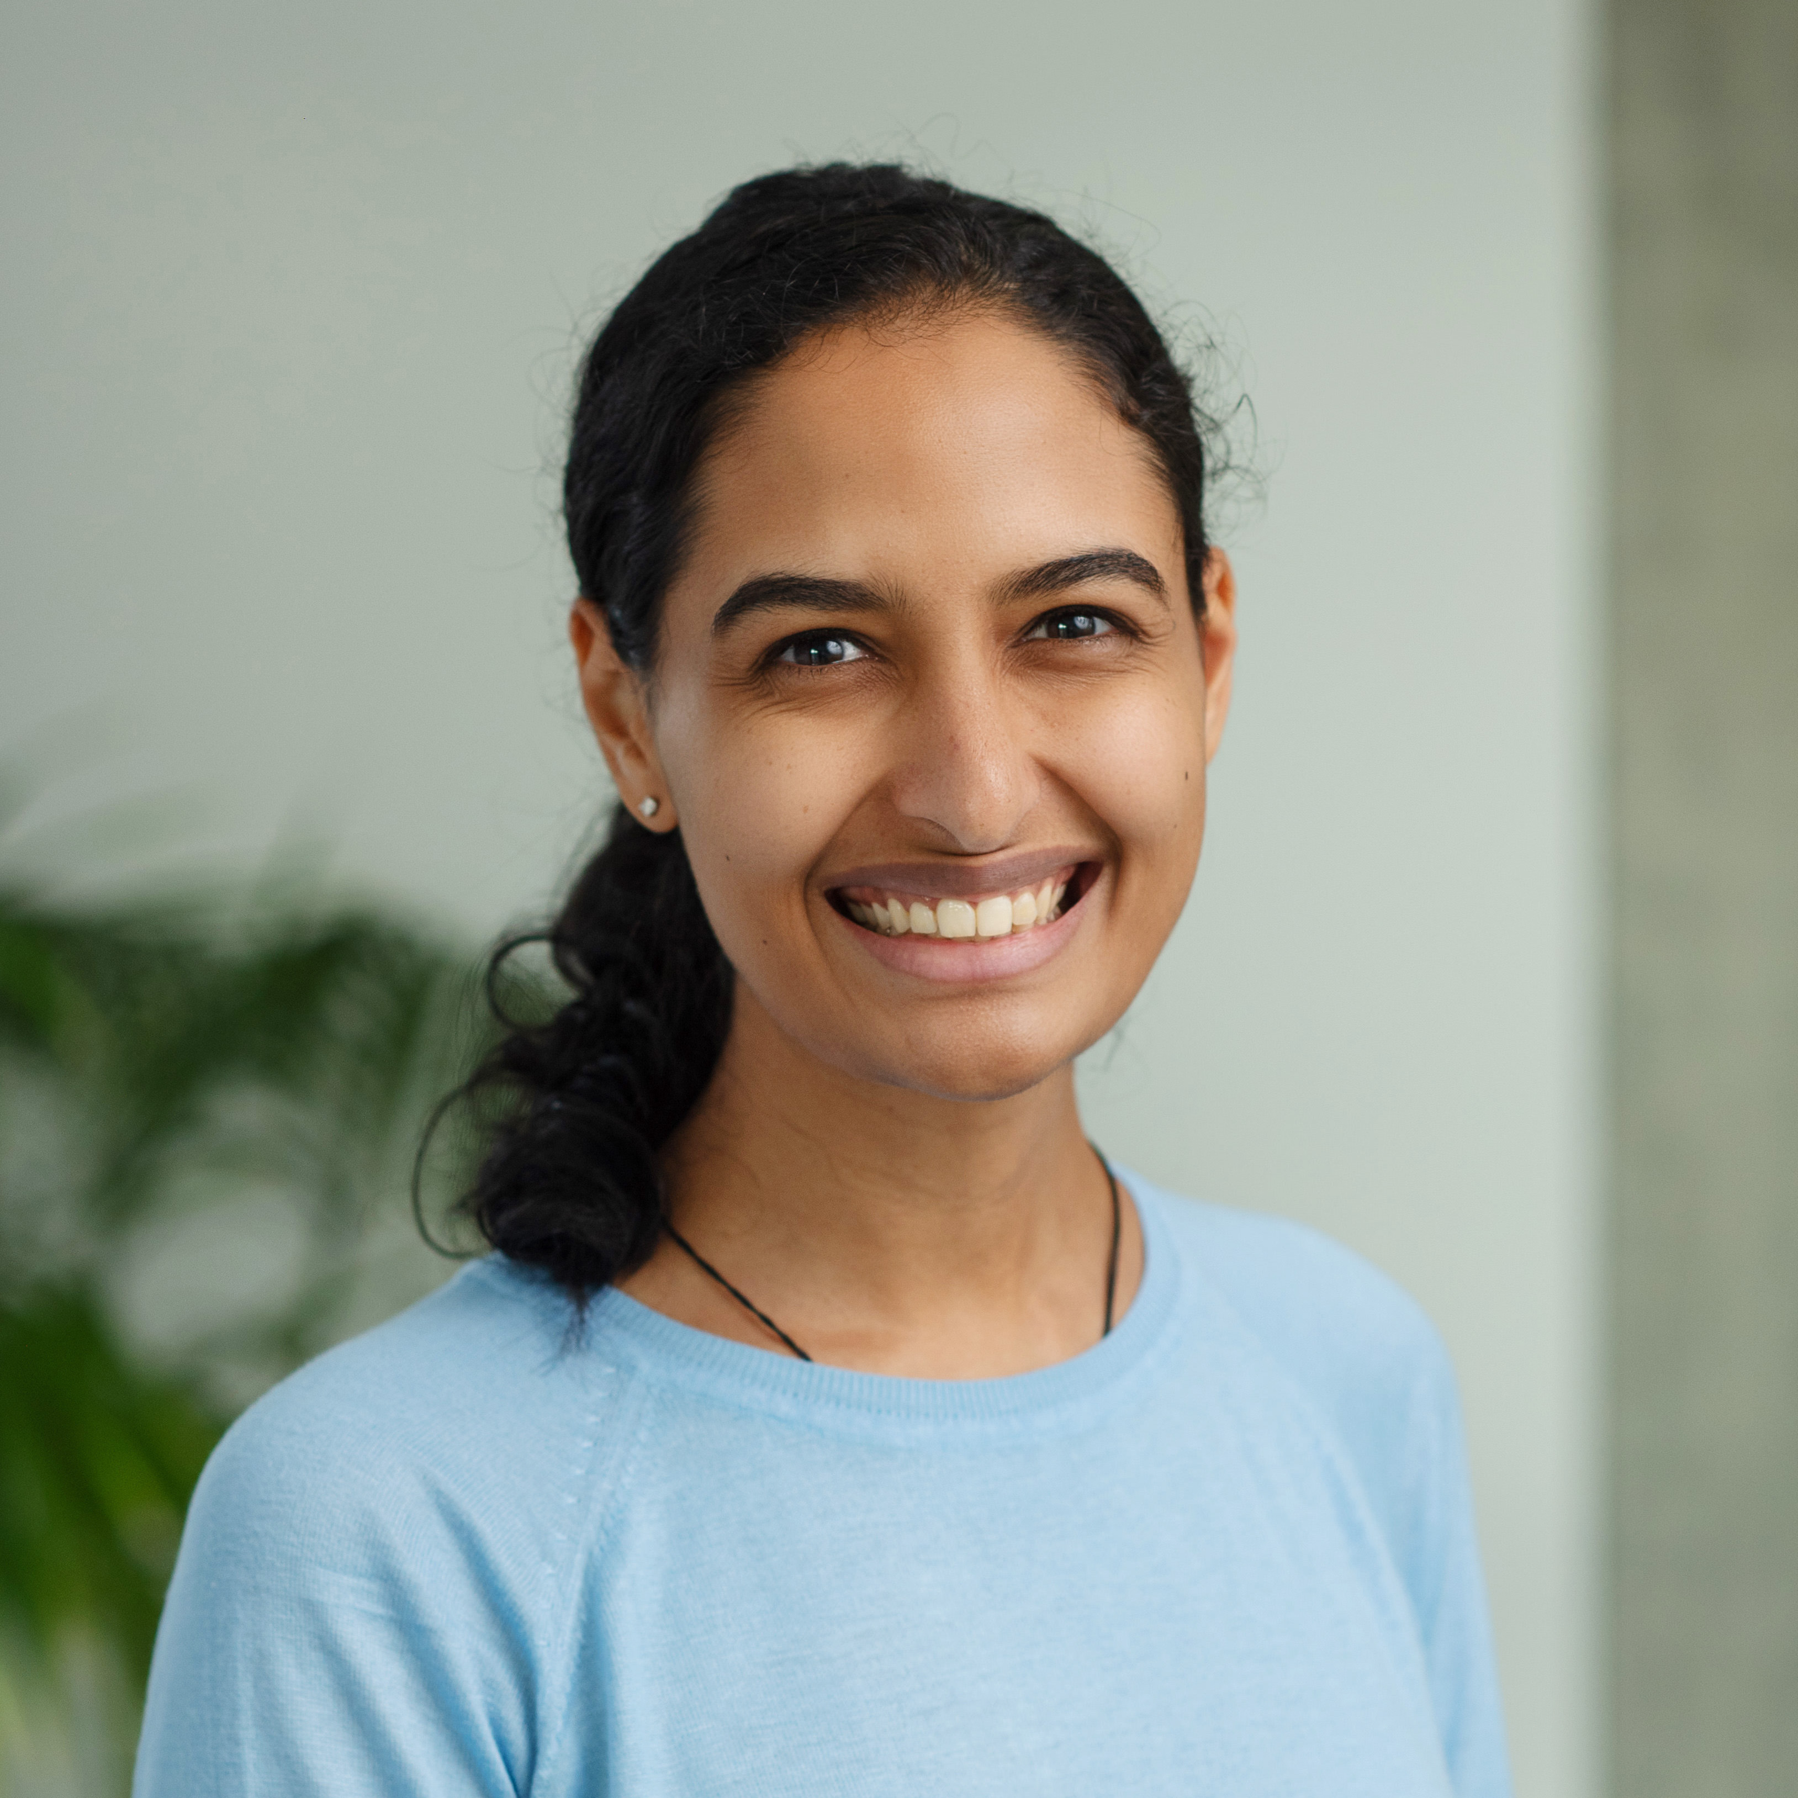
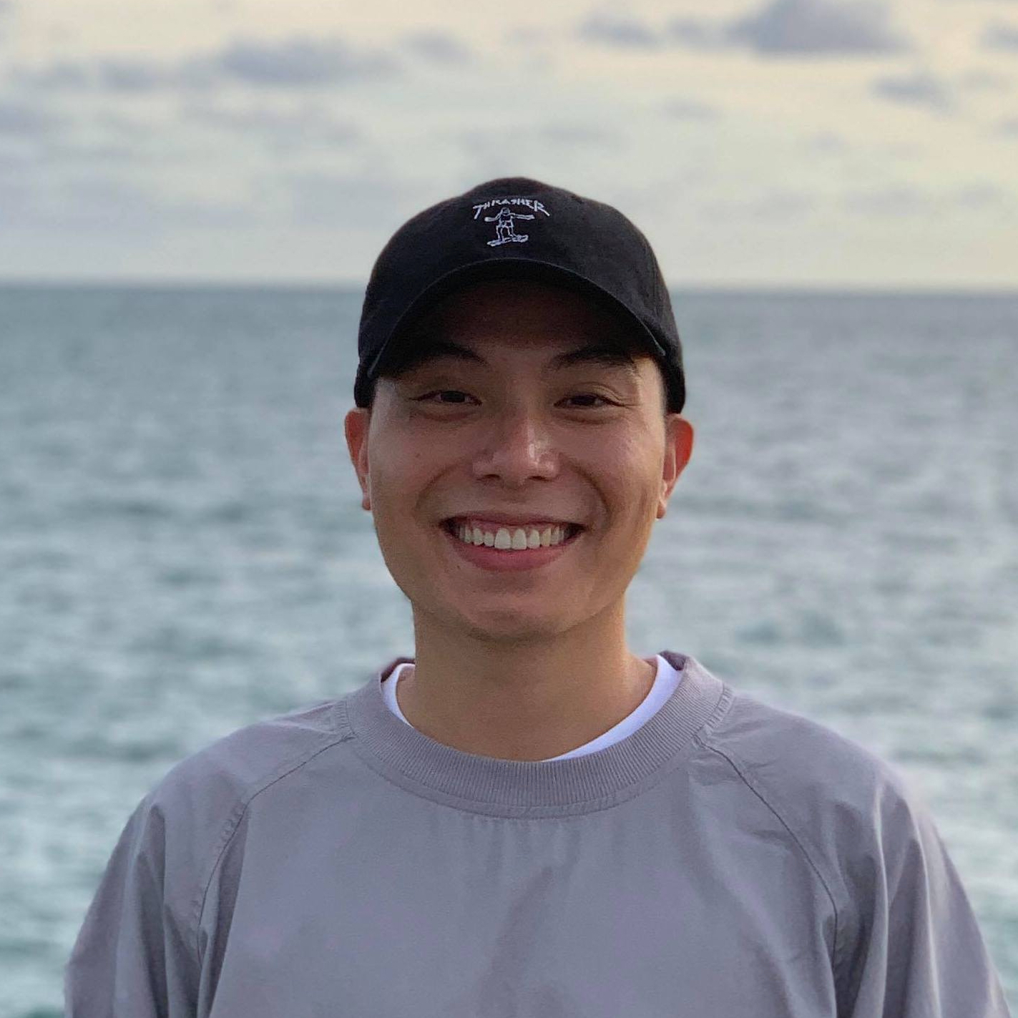
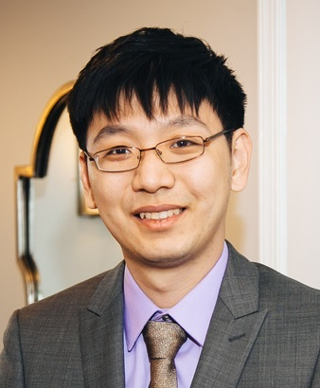
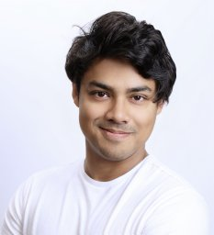
The Hard Positive Truth about Vision-Language Compositionality
Amita Kamath Cheng-Yu Hsieh Kai-Wei Chang Ranjay Krishna
Workshop on Visual Concepts
September 30, 2024
Notes:
Hi! My name is Amita, and I’m going to present our work titled The Hard Positive Truth about Vision-Language Compositionality.

Slide 2
What is Compositionality?
Vision-Language
“The meaning of the whole is a function of the meaning of its parts.”
Recognizing the effect of word swaps and replacements on sentence meaning
… in the context of an image
a.k.a. Fine-grained Vision-Language Understanding
Notes:
So what IS Compositionality? You can define it as The meaning of the whole being a function of the meaning of its parts. We operationalize this as recognizing the effect of word swaps and replacements on sentence meaning. VISION-LANGUAGE compositionality, is this same thing IN the context of an image. It’s also referred to as Fine-grained vision-language understanding.

Slide 3
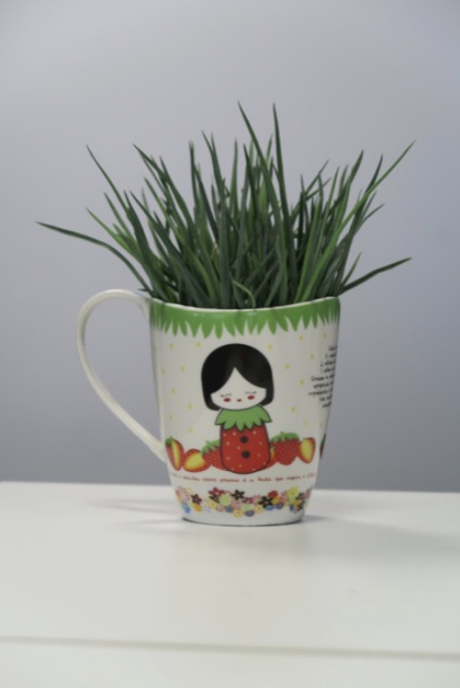
Background
Winoground: Probing Vision and Language Models for Visio-Linguistic Compositionality
Thrush et al, CVPR 2022
a mug in some grass
some grass in a mug
“hard negative”

Slide 4
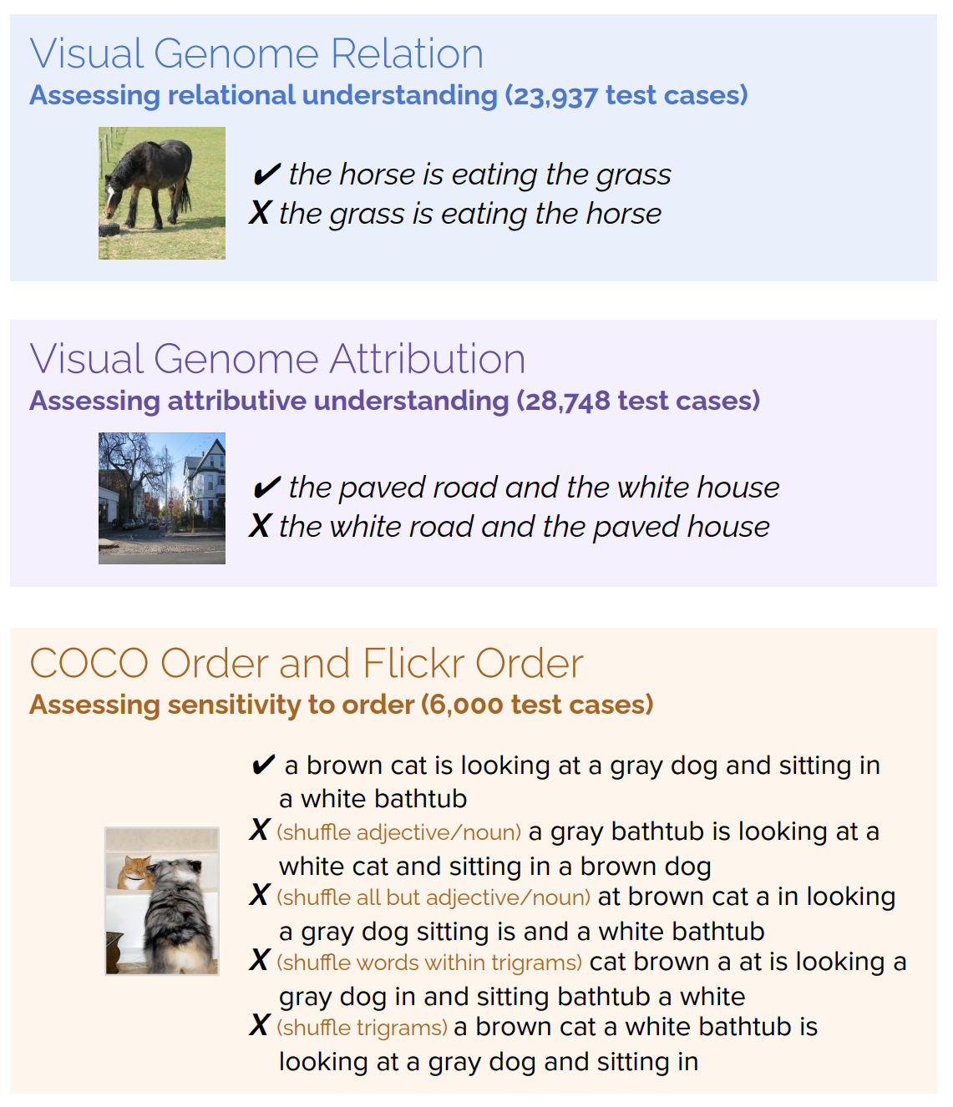
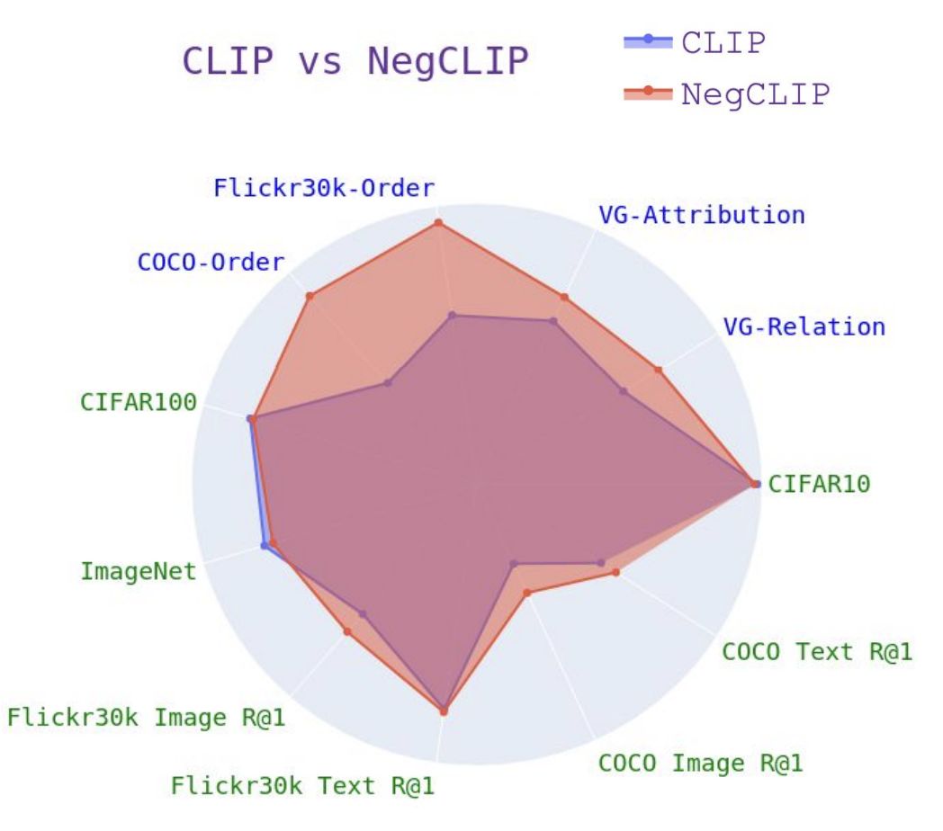
Background
When and Why VL Models Behave like Bags-of-Words, and What to Do about it
Yuksekgonul et al, ICLR 2023
Finetune

Slide 5
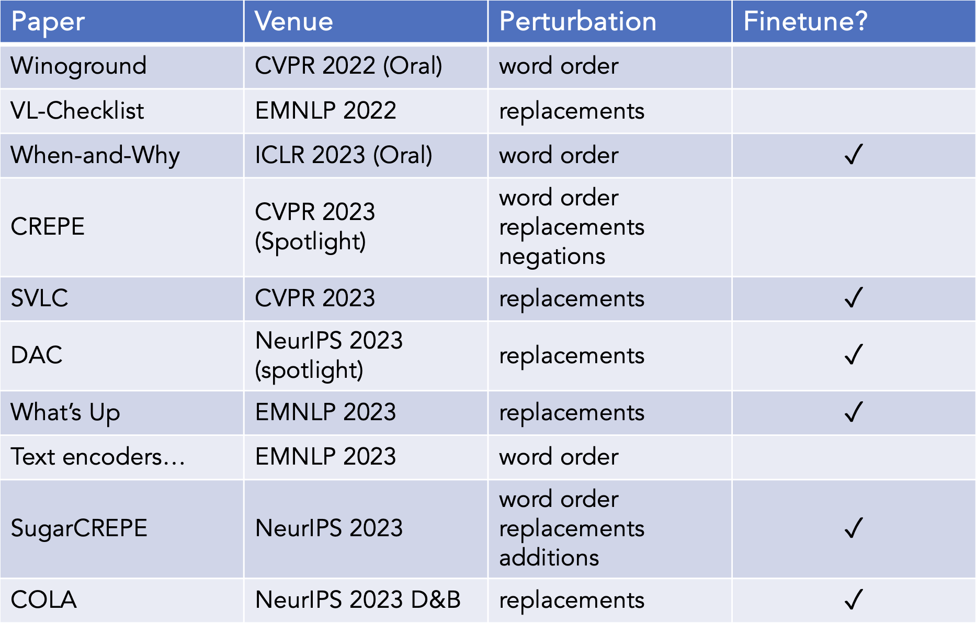
Background

Slide 6
Background
Goal: Teach models to understand
how word order / word replacements
impact meaning

Slide 7
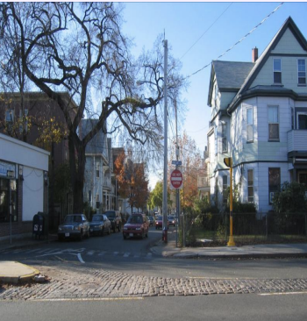
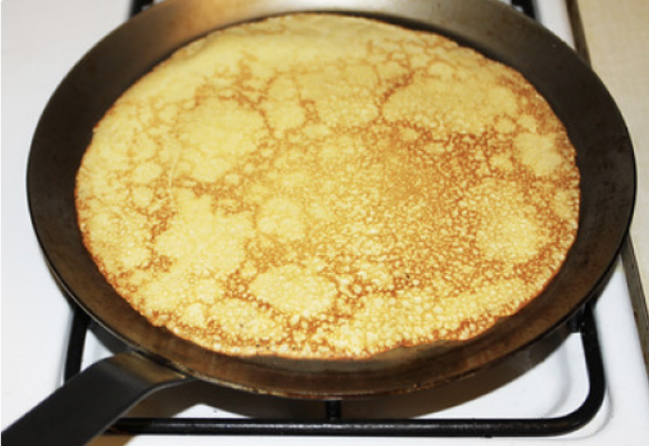
But…
the paved road and the white house
✓
the white road and the paved house
❌
crepe on a skillet
✓
boats on a skillet
❌
Notes:
However, these works all consider only hard NEGATIVES, which means a word order swap or replacement NECESSARILY makes the caption a bad fit for the image.

Slide 8
So…
Goal: Teach models to understand
how word order / word replacements
impact meaning
that
change
, always
Which isn’t true (and isn’t compositionality)

Slide 9
We introduce Hard Positives
Hard Negative: semantics-altering change to the original caption
Hard Positive: semantics-retaining change to the original caption
the paved road and the white house
✓
the white road and the paved house
❌
the white house and the paved road
✓

Slide 10
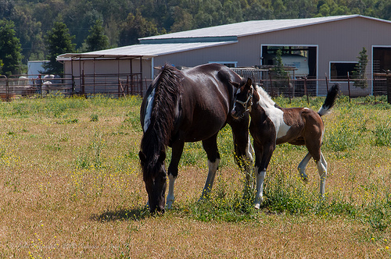
Existing work
Captions | CLIP | Hard Negative Finetuned
 | 0.236 | 0.152
 | 0.240 | 0.143
Original Caption c
brown grass
Hard Negative c_{N}
blue grass
Image i

Slide 11
Existing work
Captions | CLIP | Hard Negative Finetuned | Ours
 | 0.236 | 0.152 | 0.240
 | 0.240 | 0.143 | 0.231
 | 0.249 | 0.134 | 0.241
Captions | CLIP | Hard Negative Finetuned
 | 0.236 | 0.152
 | 0.240 | 0.143
Original Caption c
brown grass
Hard Negative c_{N}
blue grass
Hard Positive c_{P}
chestnut grass
Image i
Our work

Slide 12
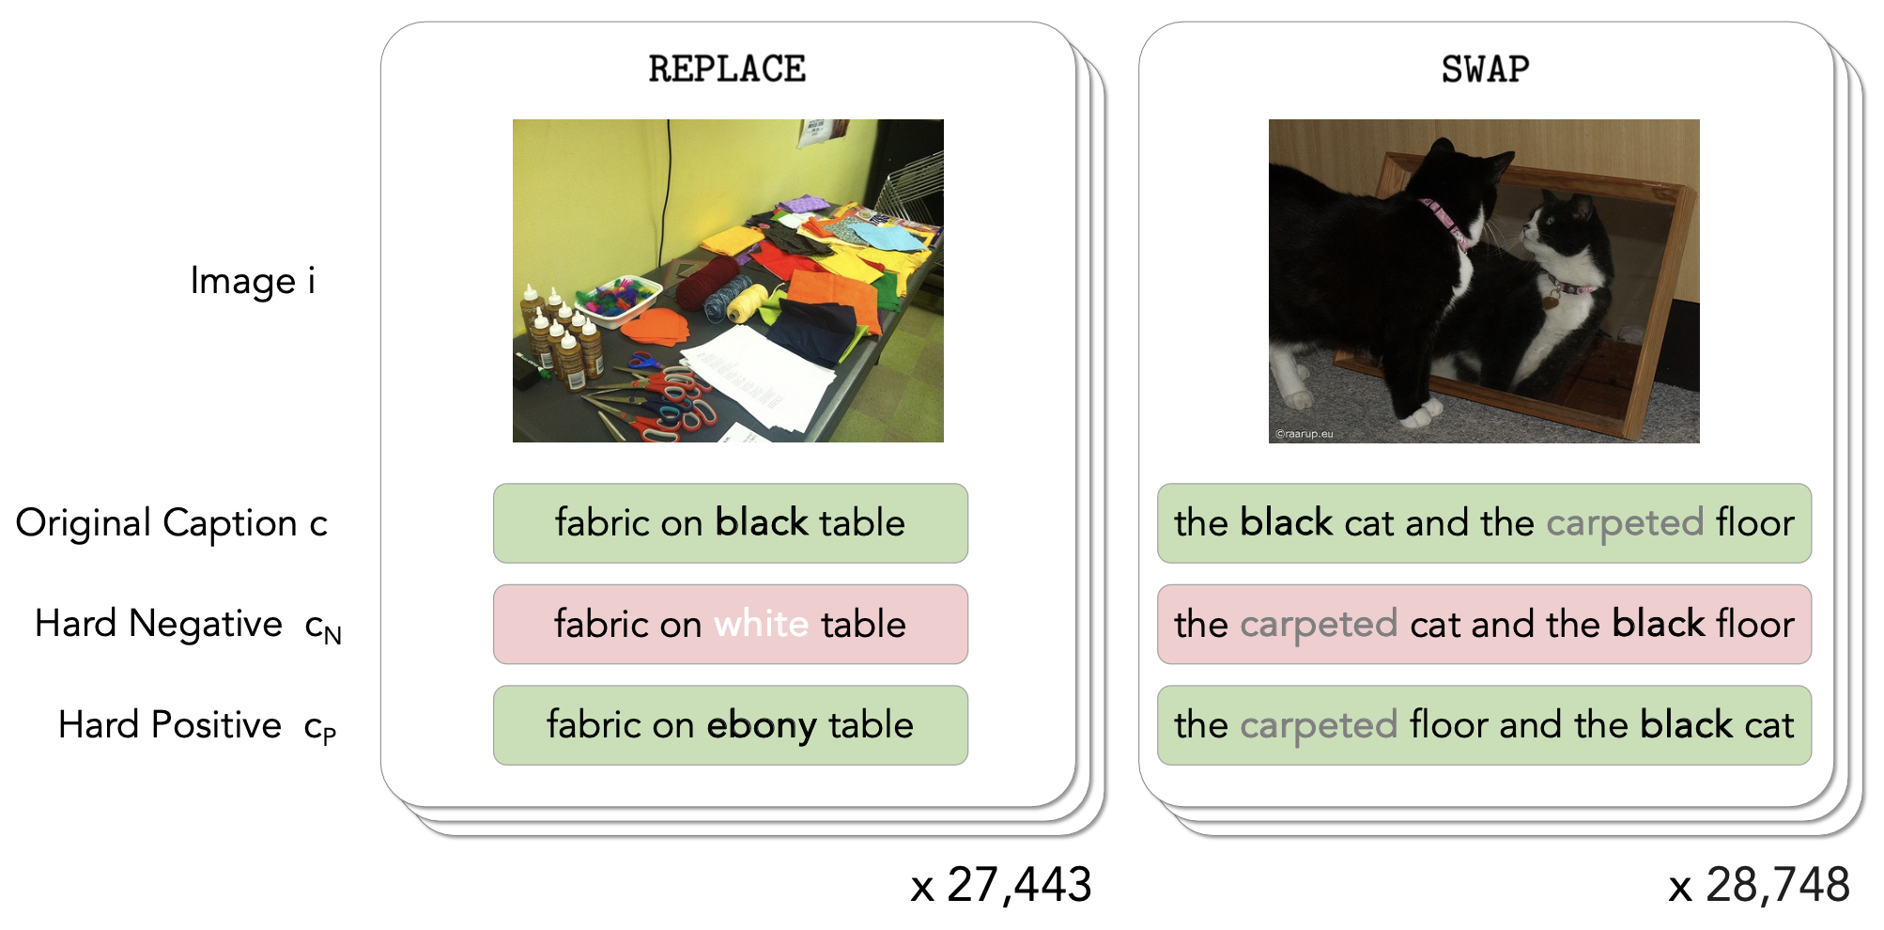
Hard Positive Benchmark!
hand-crafted
programmatic

Slide 13
Model behavior
Ideal
Model
HNFT Model
observable!
c
c_{P}
c
c_{N}
c_{P}
c
s(·|i)
c_{P}
or even
c_{N}
c_{N}
c_{P}

Slide 14
Evaluation
– Metrics

Slide 15
Evaluation
VLMs are oversensitive…

Slide 16
Evaluation
VLMs are oversensitive…
and hard negative finetuning makes them worse – up to a 39% drop!
Hard negative finetuning doesn’t help models understand when perturbations matter

Slide 17
Evaluation
Oversensitivity transfers across perturbation types
Hard Negative finetuning lowers scores of the original captions too!
Hurts use cases that use the score itself, like caption evaluation

Slide 18
Improving model performance

Slide 19
Improving model performance
Programmatically generate hard positives from COCO
Finetune CLIP on hard negatives and hard positives
Details in the paper!

Slide 20
Improving model performance
Adding hard positives to finetuning improves model performance – without lowering scores!
Performance on standard benchmarks ✓
Room for improvement!
this could be you!

Slide 21
Refer to the paper for experiments with:
Different variants of CLIP
Model size
Text encoder, Vision encoder
Pretraining data
Changing the ratio between hard positives and hard negatives

Slide 22
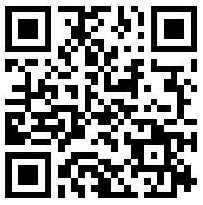
Thank you!
Hard Positives: an important new aspect
of VL compositionality
VL models even less compositional than we thought, and
hard-negative finetuning makes them oversensitive
Our new model
performs well on both
hard negatives and
hard positives!
Find me at Poster Session 3
on Wednesday morning
at #100!

